Slide 1
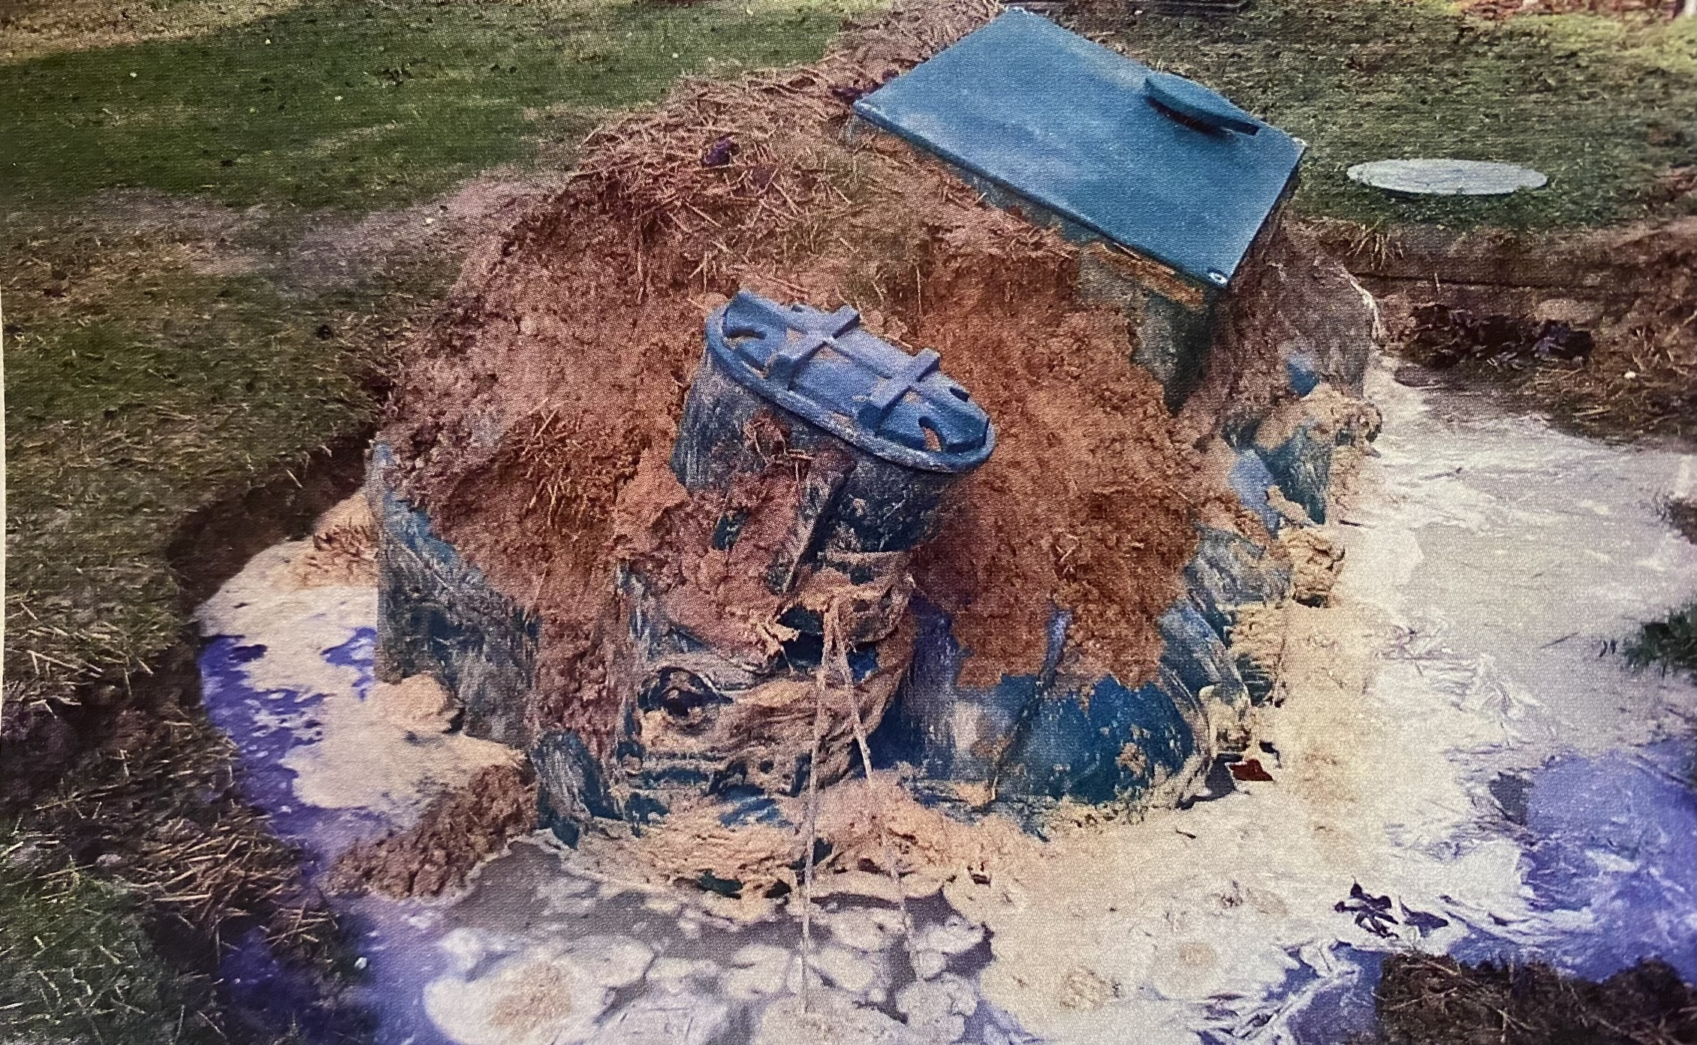

POWTS SOLUTIONS FOR CHALLENGING SITES

Slide 2
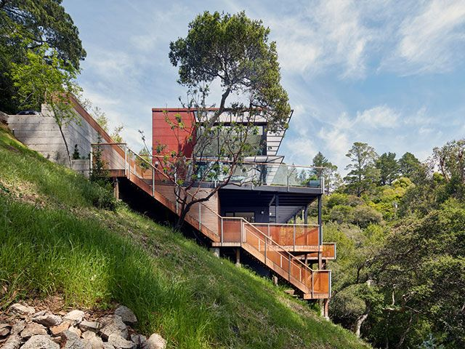
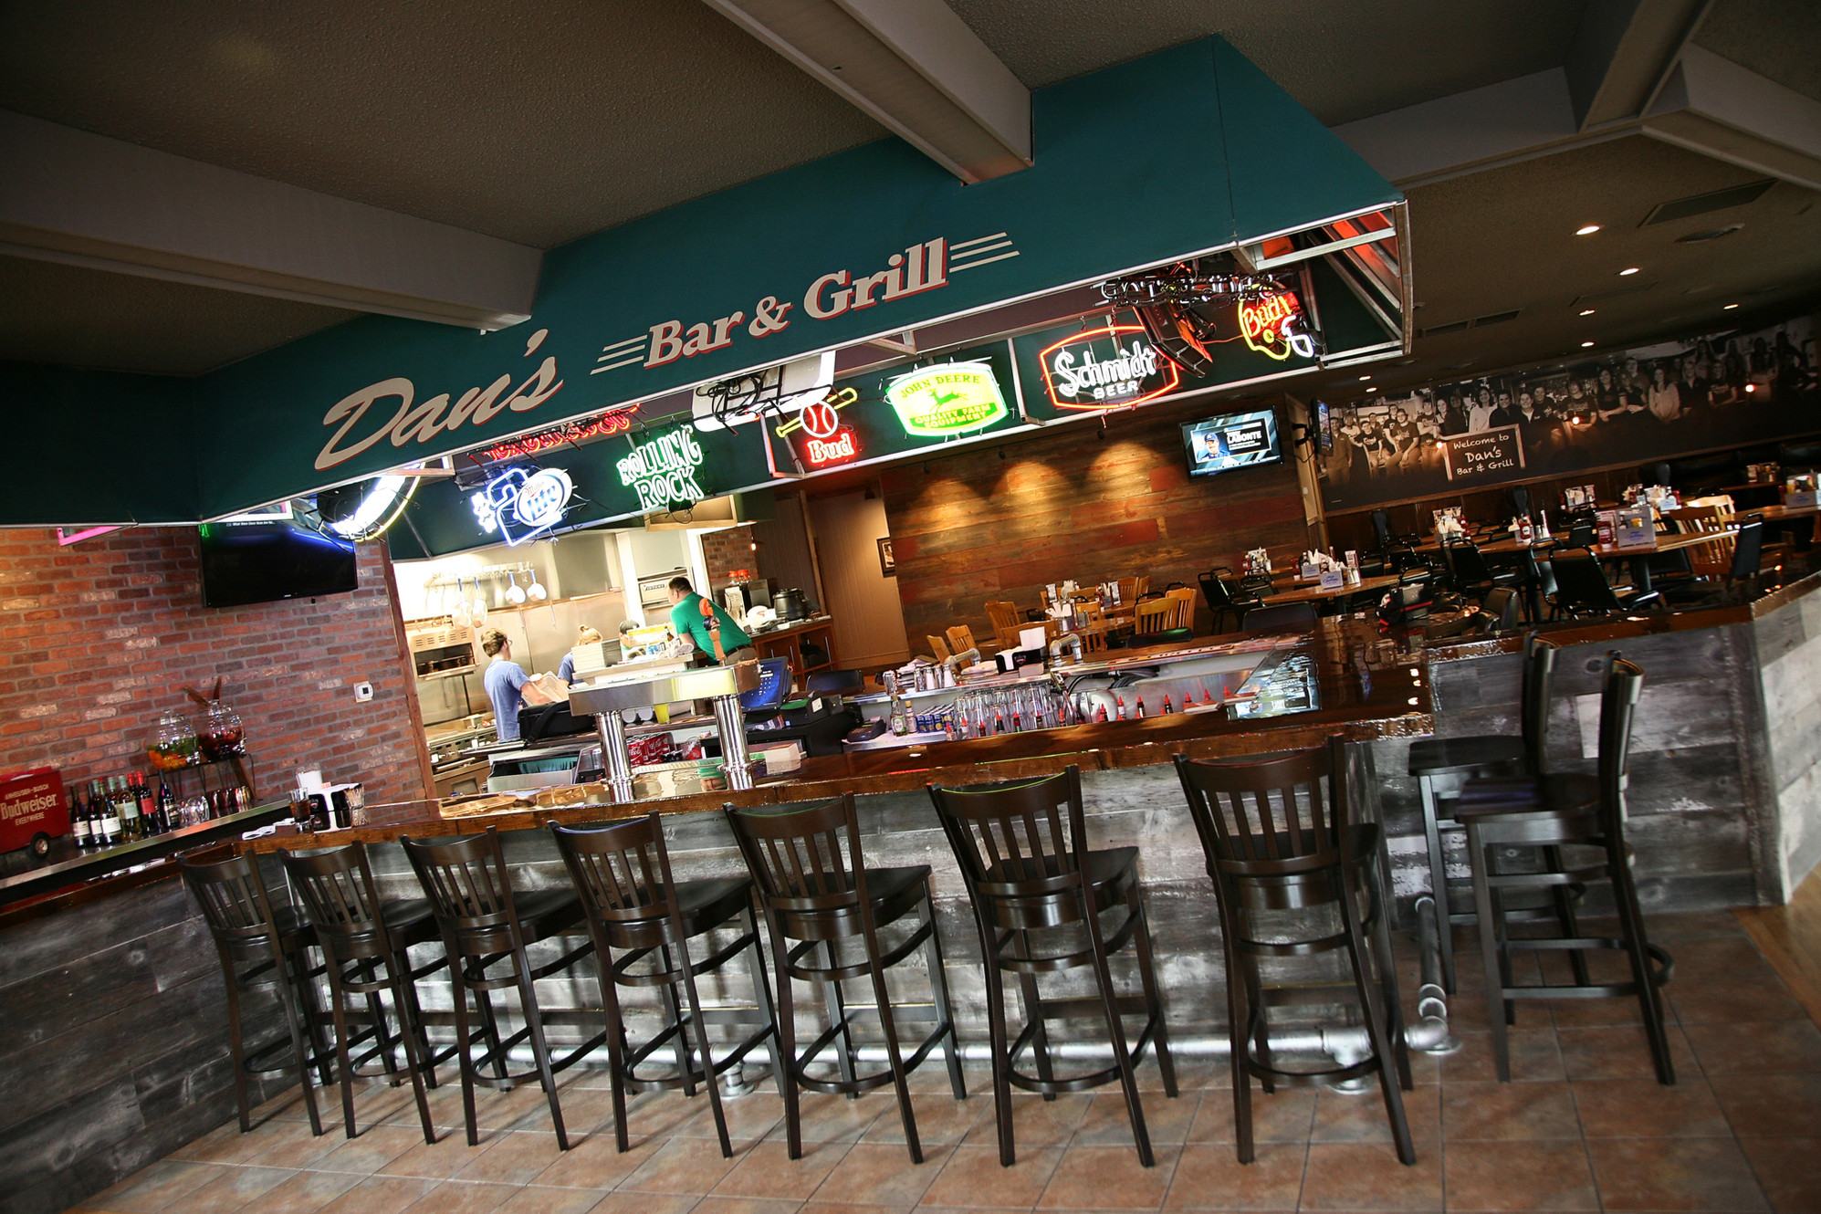
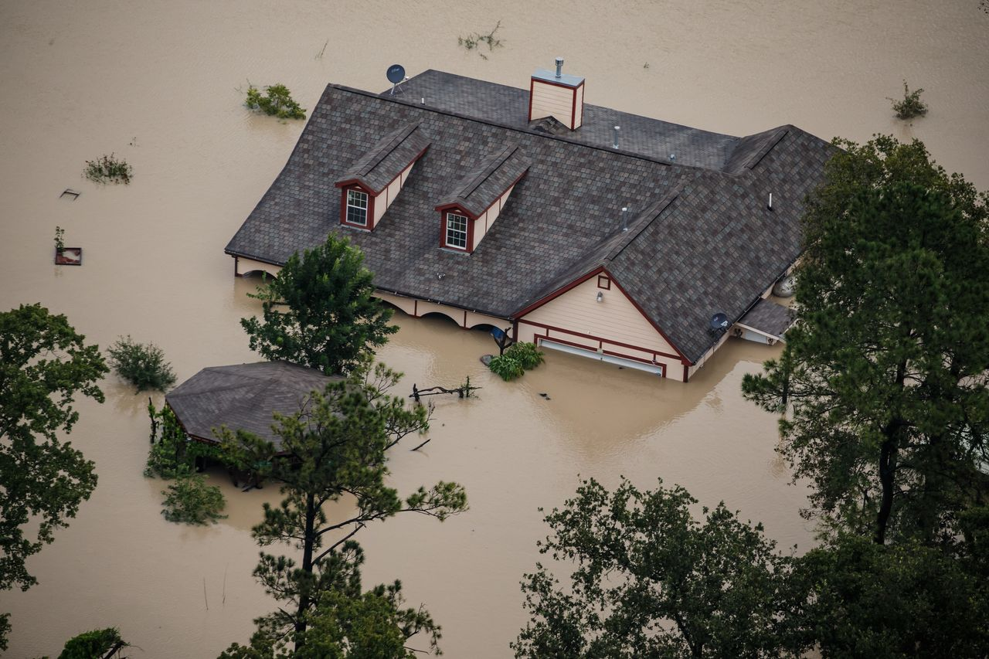
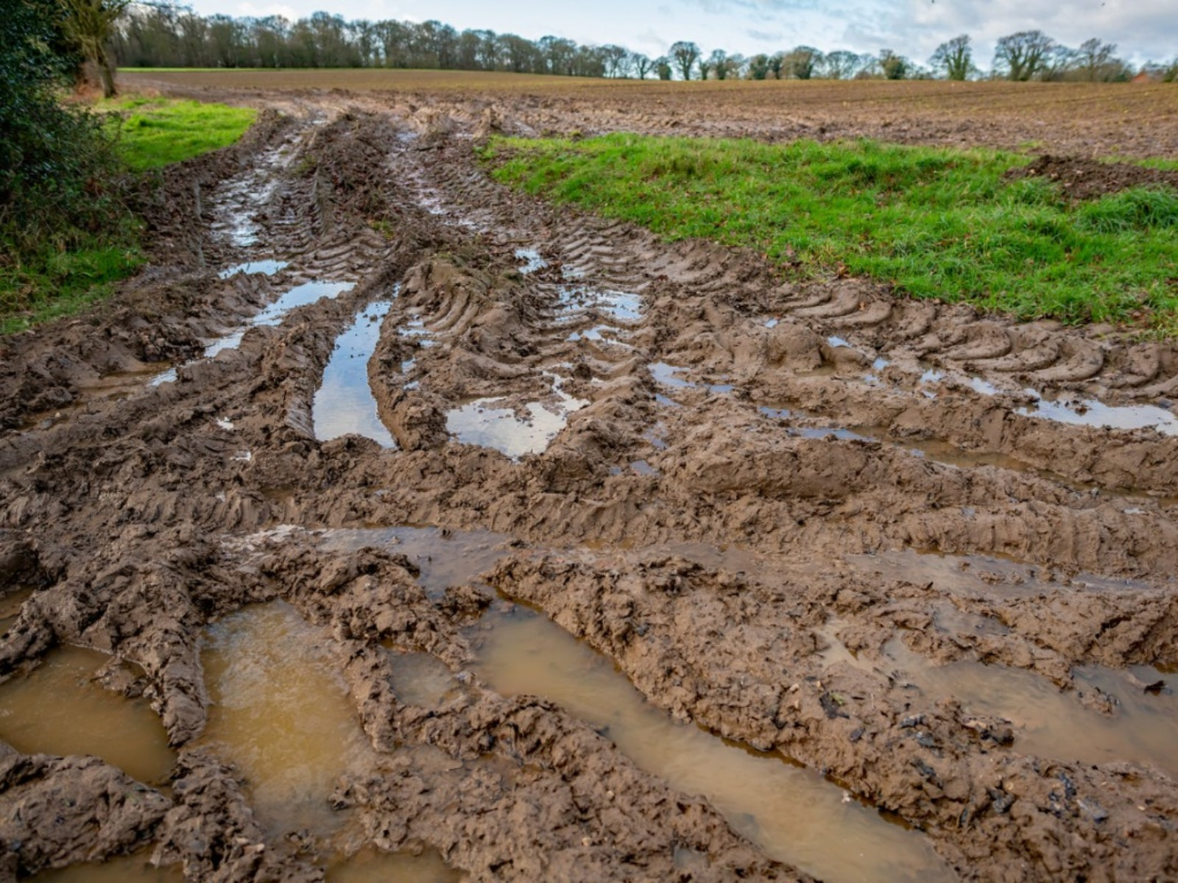
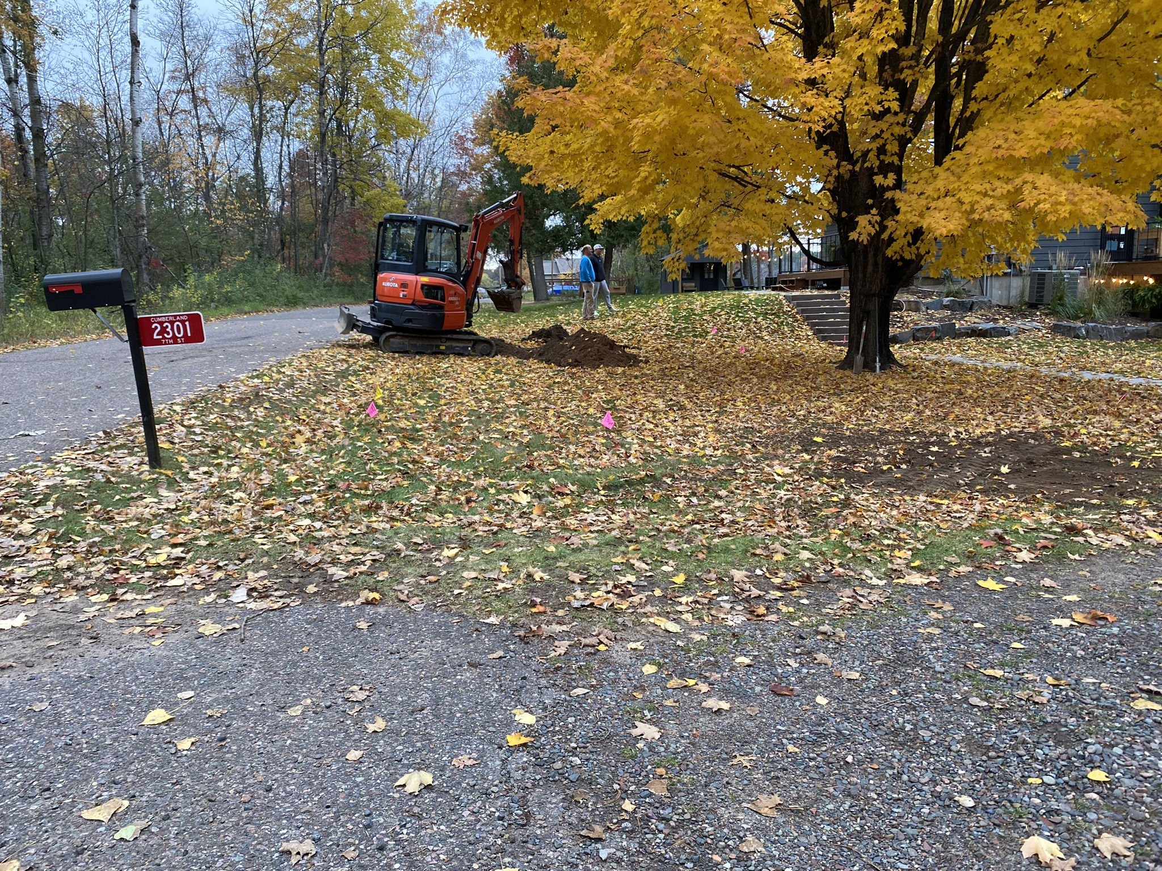
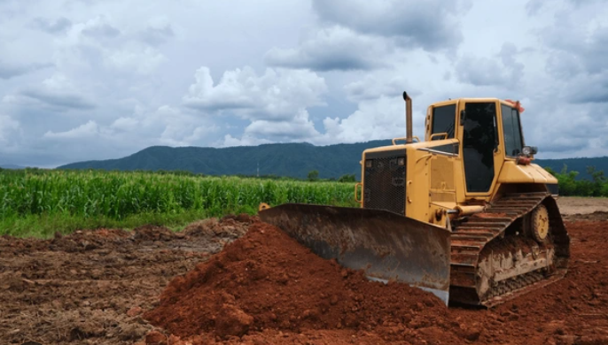
WHAT IS A CHALLENGING SITE?

Slide 3
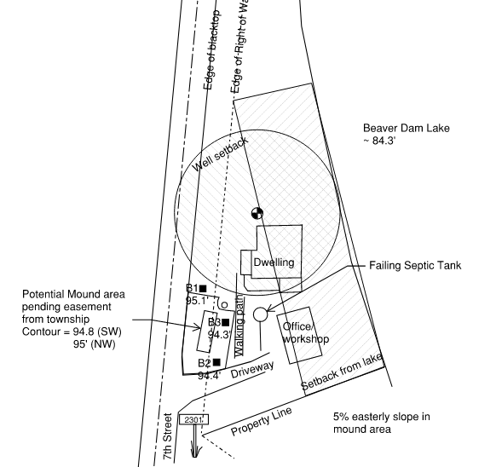
LIMITED SPACE

Slide 4
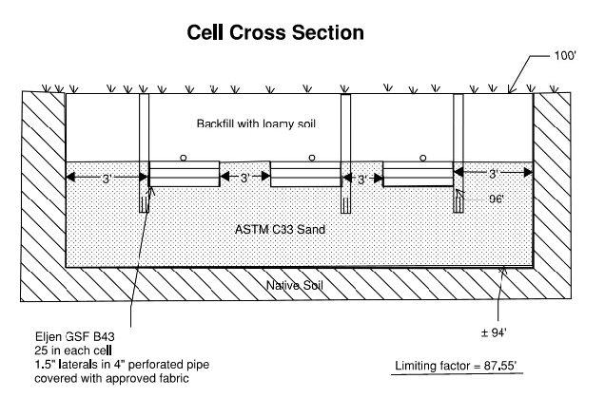
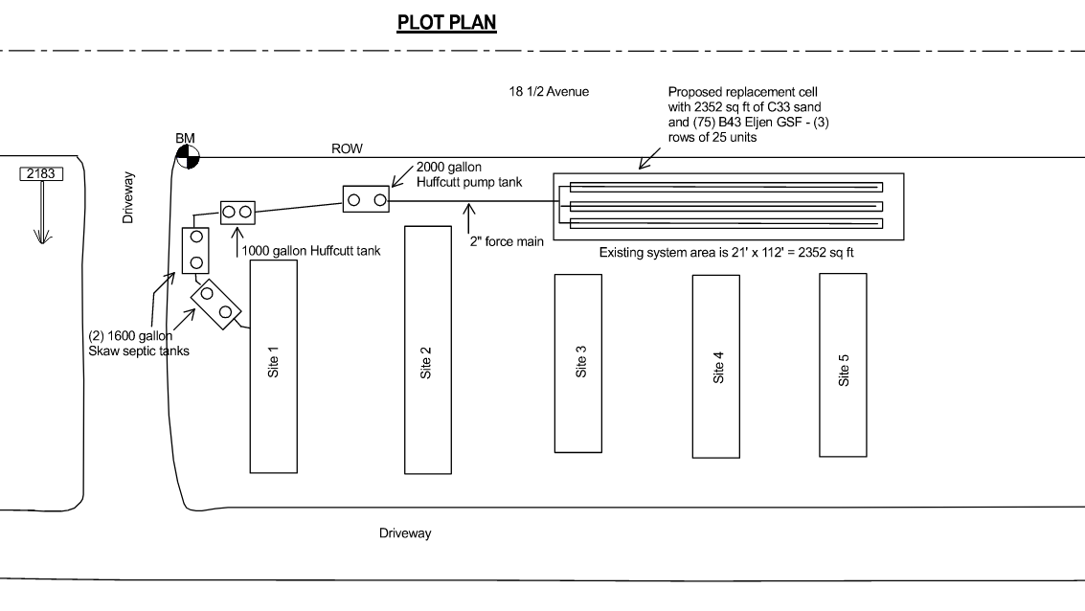
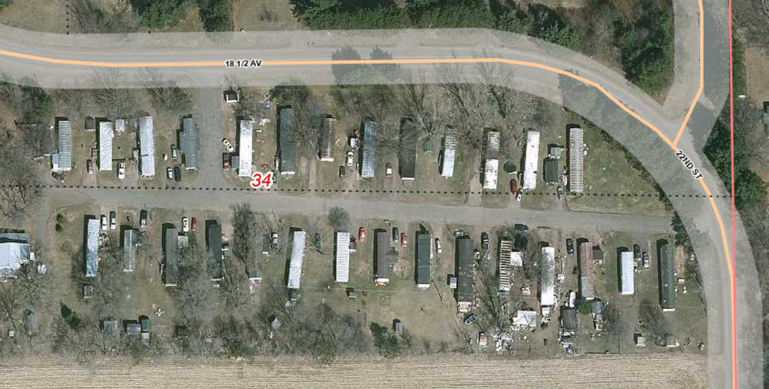
LIMITED SPACE - replacement in existing system area

Slide 5
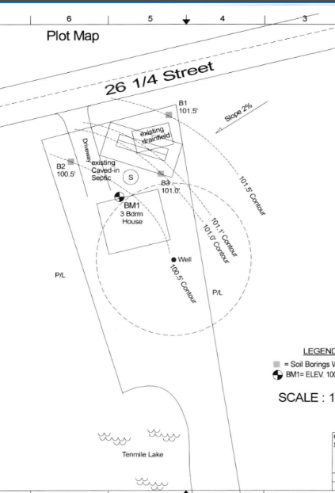
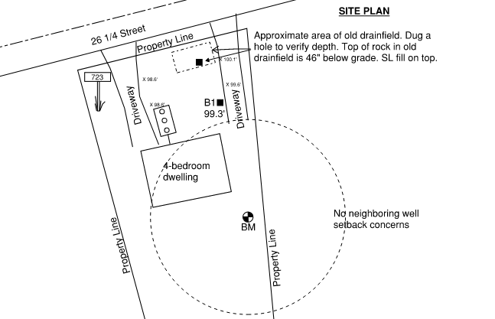
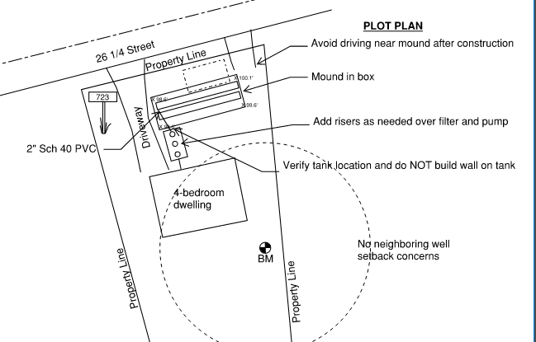
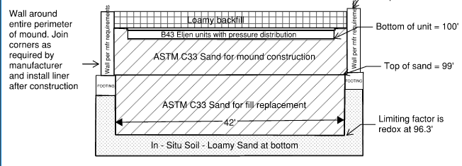
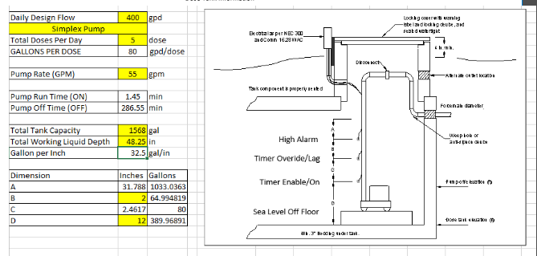
FILL SOILS

Slide 6
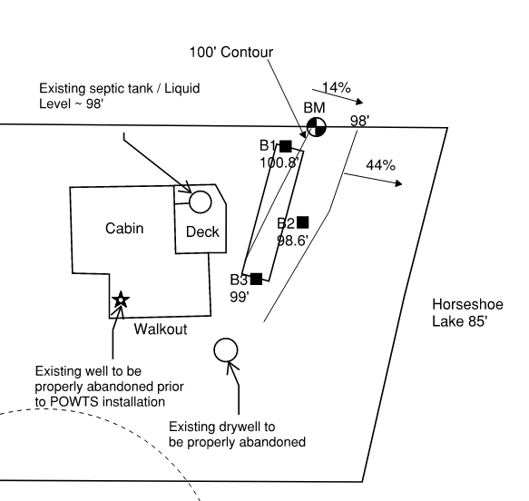
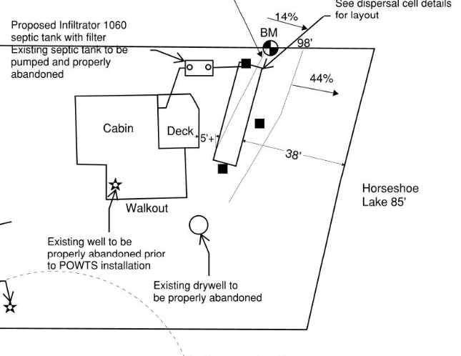
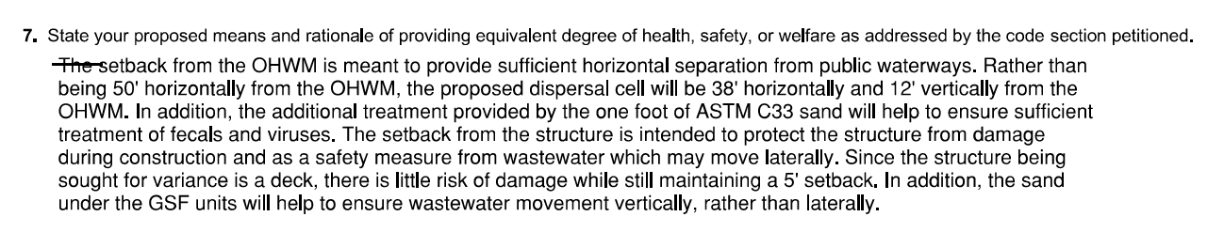
LIMITED SPACE

Slide 7
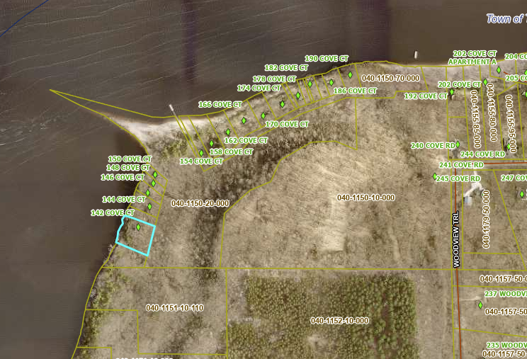
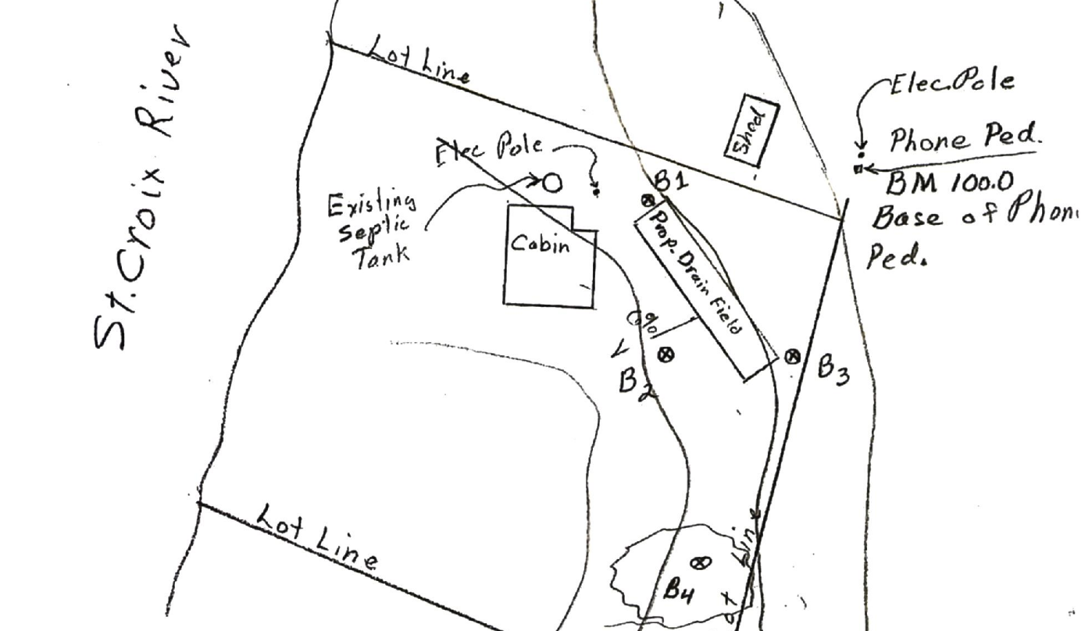
DIFFICULT ACCESS

Slide 8
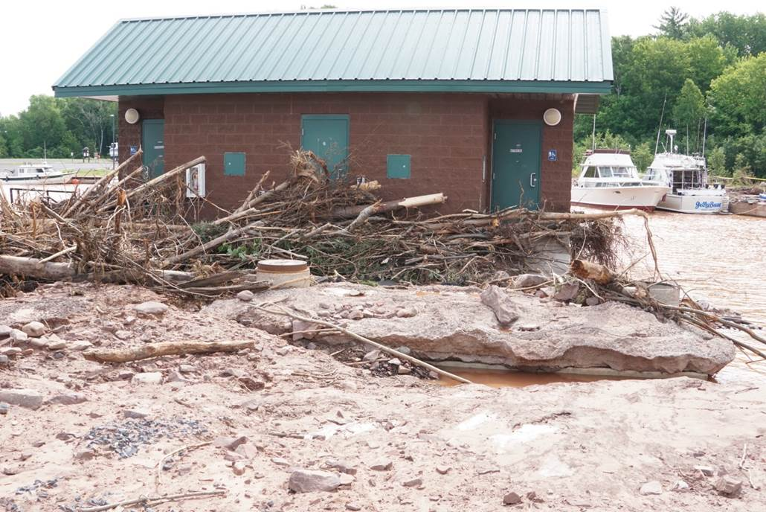
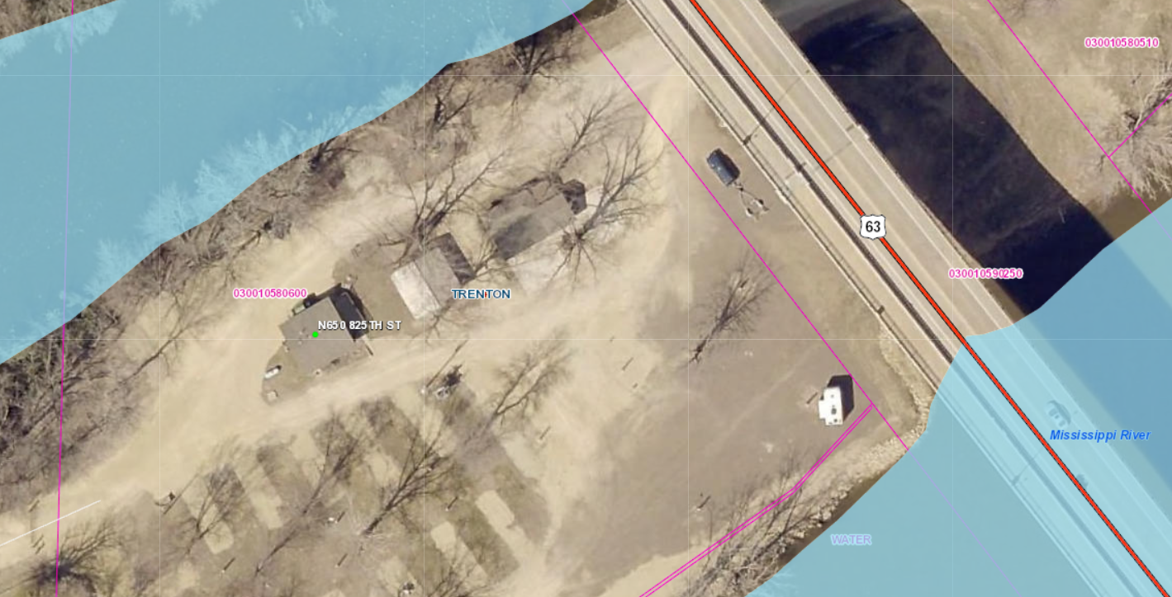
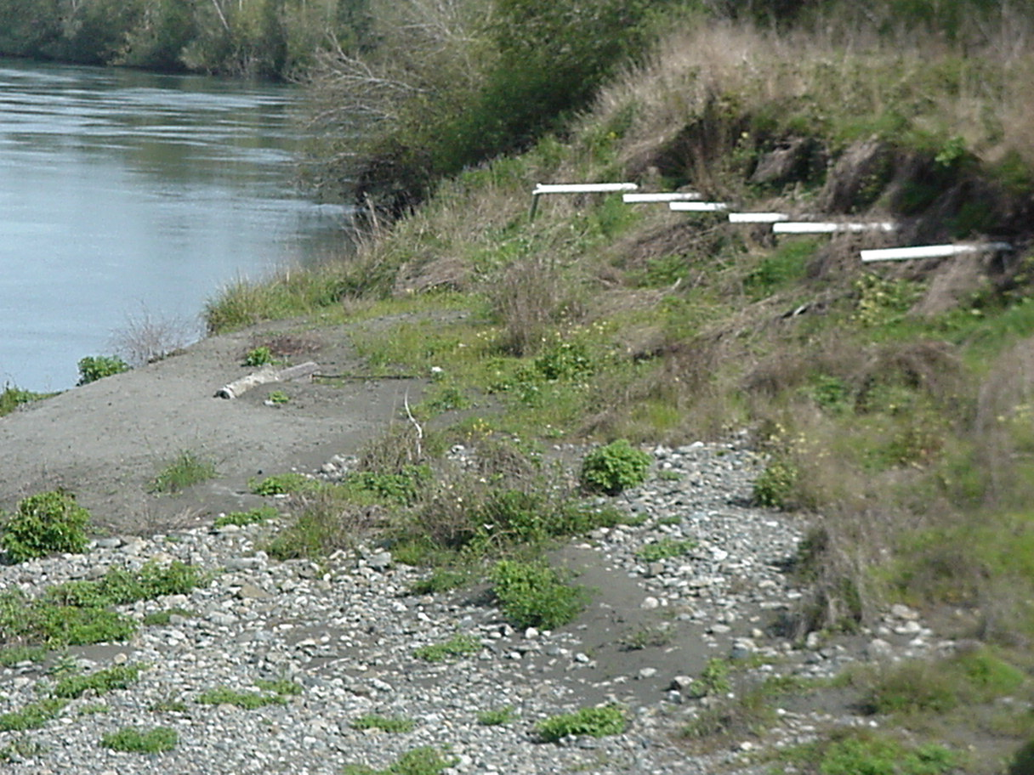
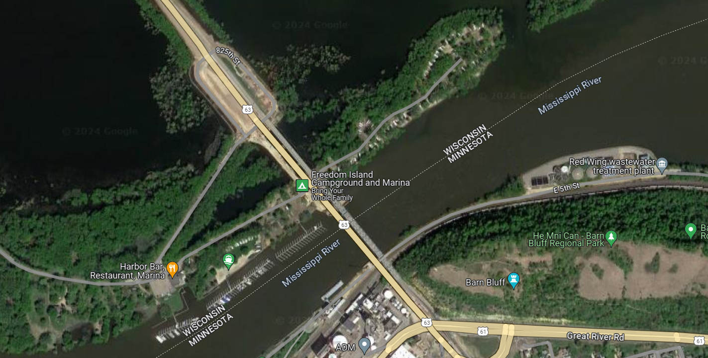
FLOODPLAIN

Slide 9
What Do We Need to Do?
What Do We Need to Do?
Recognize when doing a soil and site evaluation in or near floodplain areas.
If in a mapped floodplain, find out if it is flood fringe or floodway
  Owner may need to pay for Hydrologic / Hydraulic study/model - NOT cheap!
Determine if and what type of POWTS can be installed
Include all relevant elevation data in soil and site evalution

Slide 10
What Do We Need to Do?
If within flood fringe:
  Check with county to see if acceptable
  Ensure tank(s) is waterproofed
  Ensure tank(s) and holding components are properly anchored
  Ensure vent pipes are at least 2’ above RFE
If within floodway:
  POWTS prohibited for new development
  Check with county to find out alternatives for replacement POWTS

Slide 11
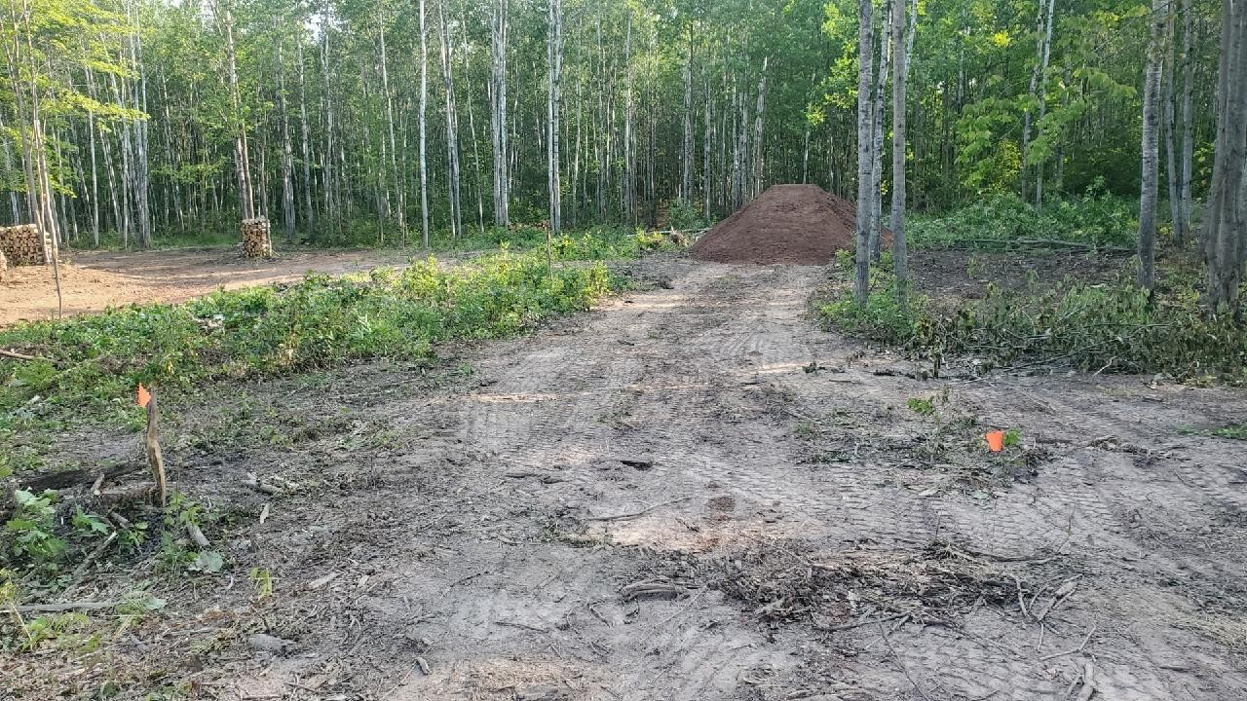
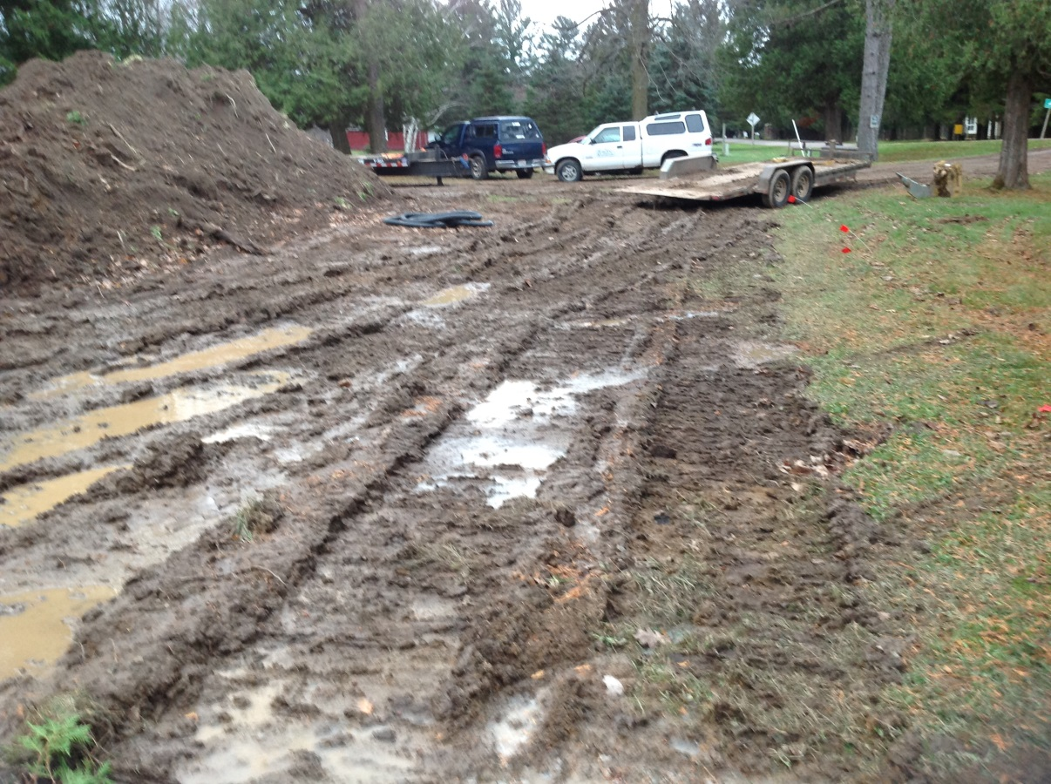
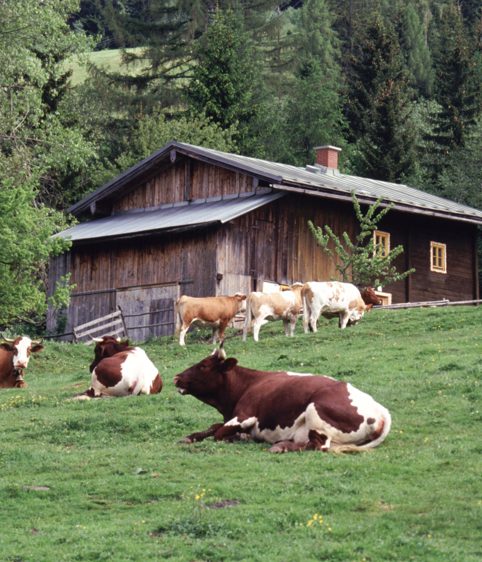
DAMAGED SITES

Slide 12
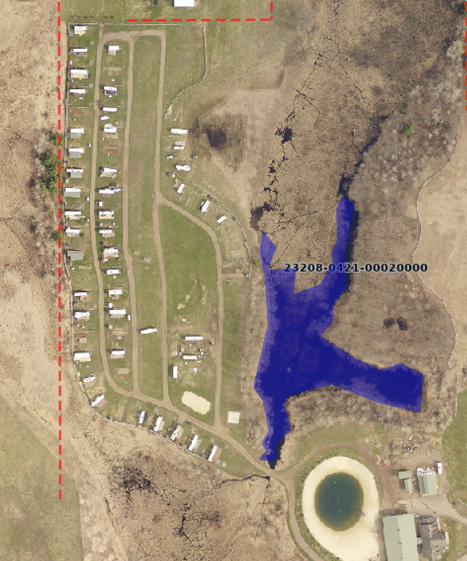
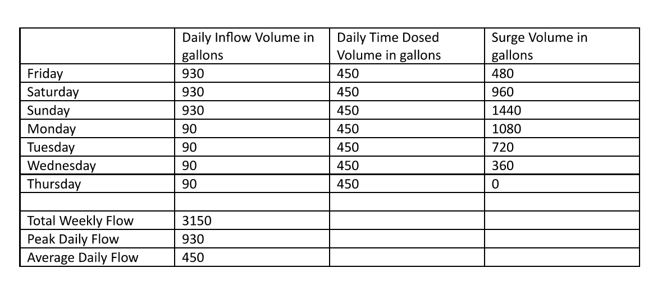
FLOW EQUALIZATION

Slide 13

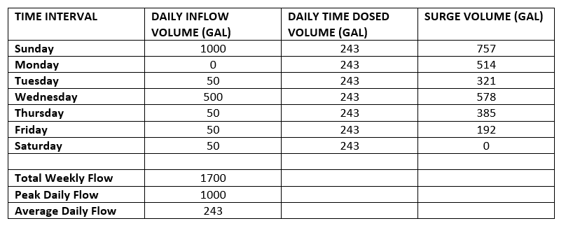
FLOW EQUALIZATION

Slide 14
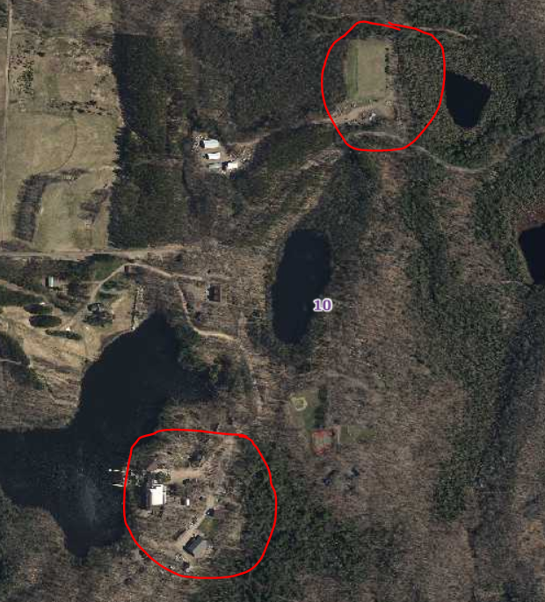
LARGE POWTS

Slide 15
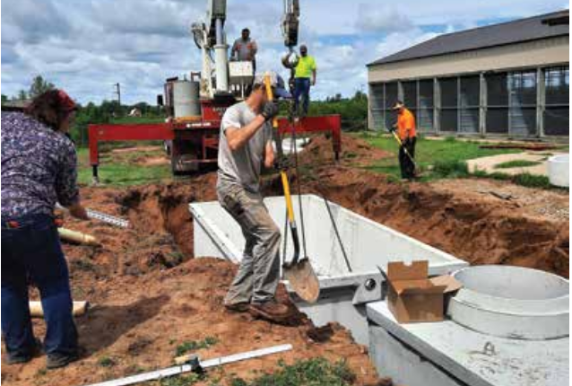
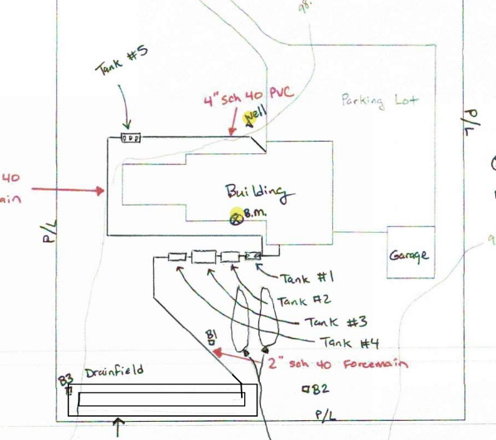
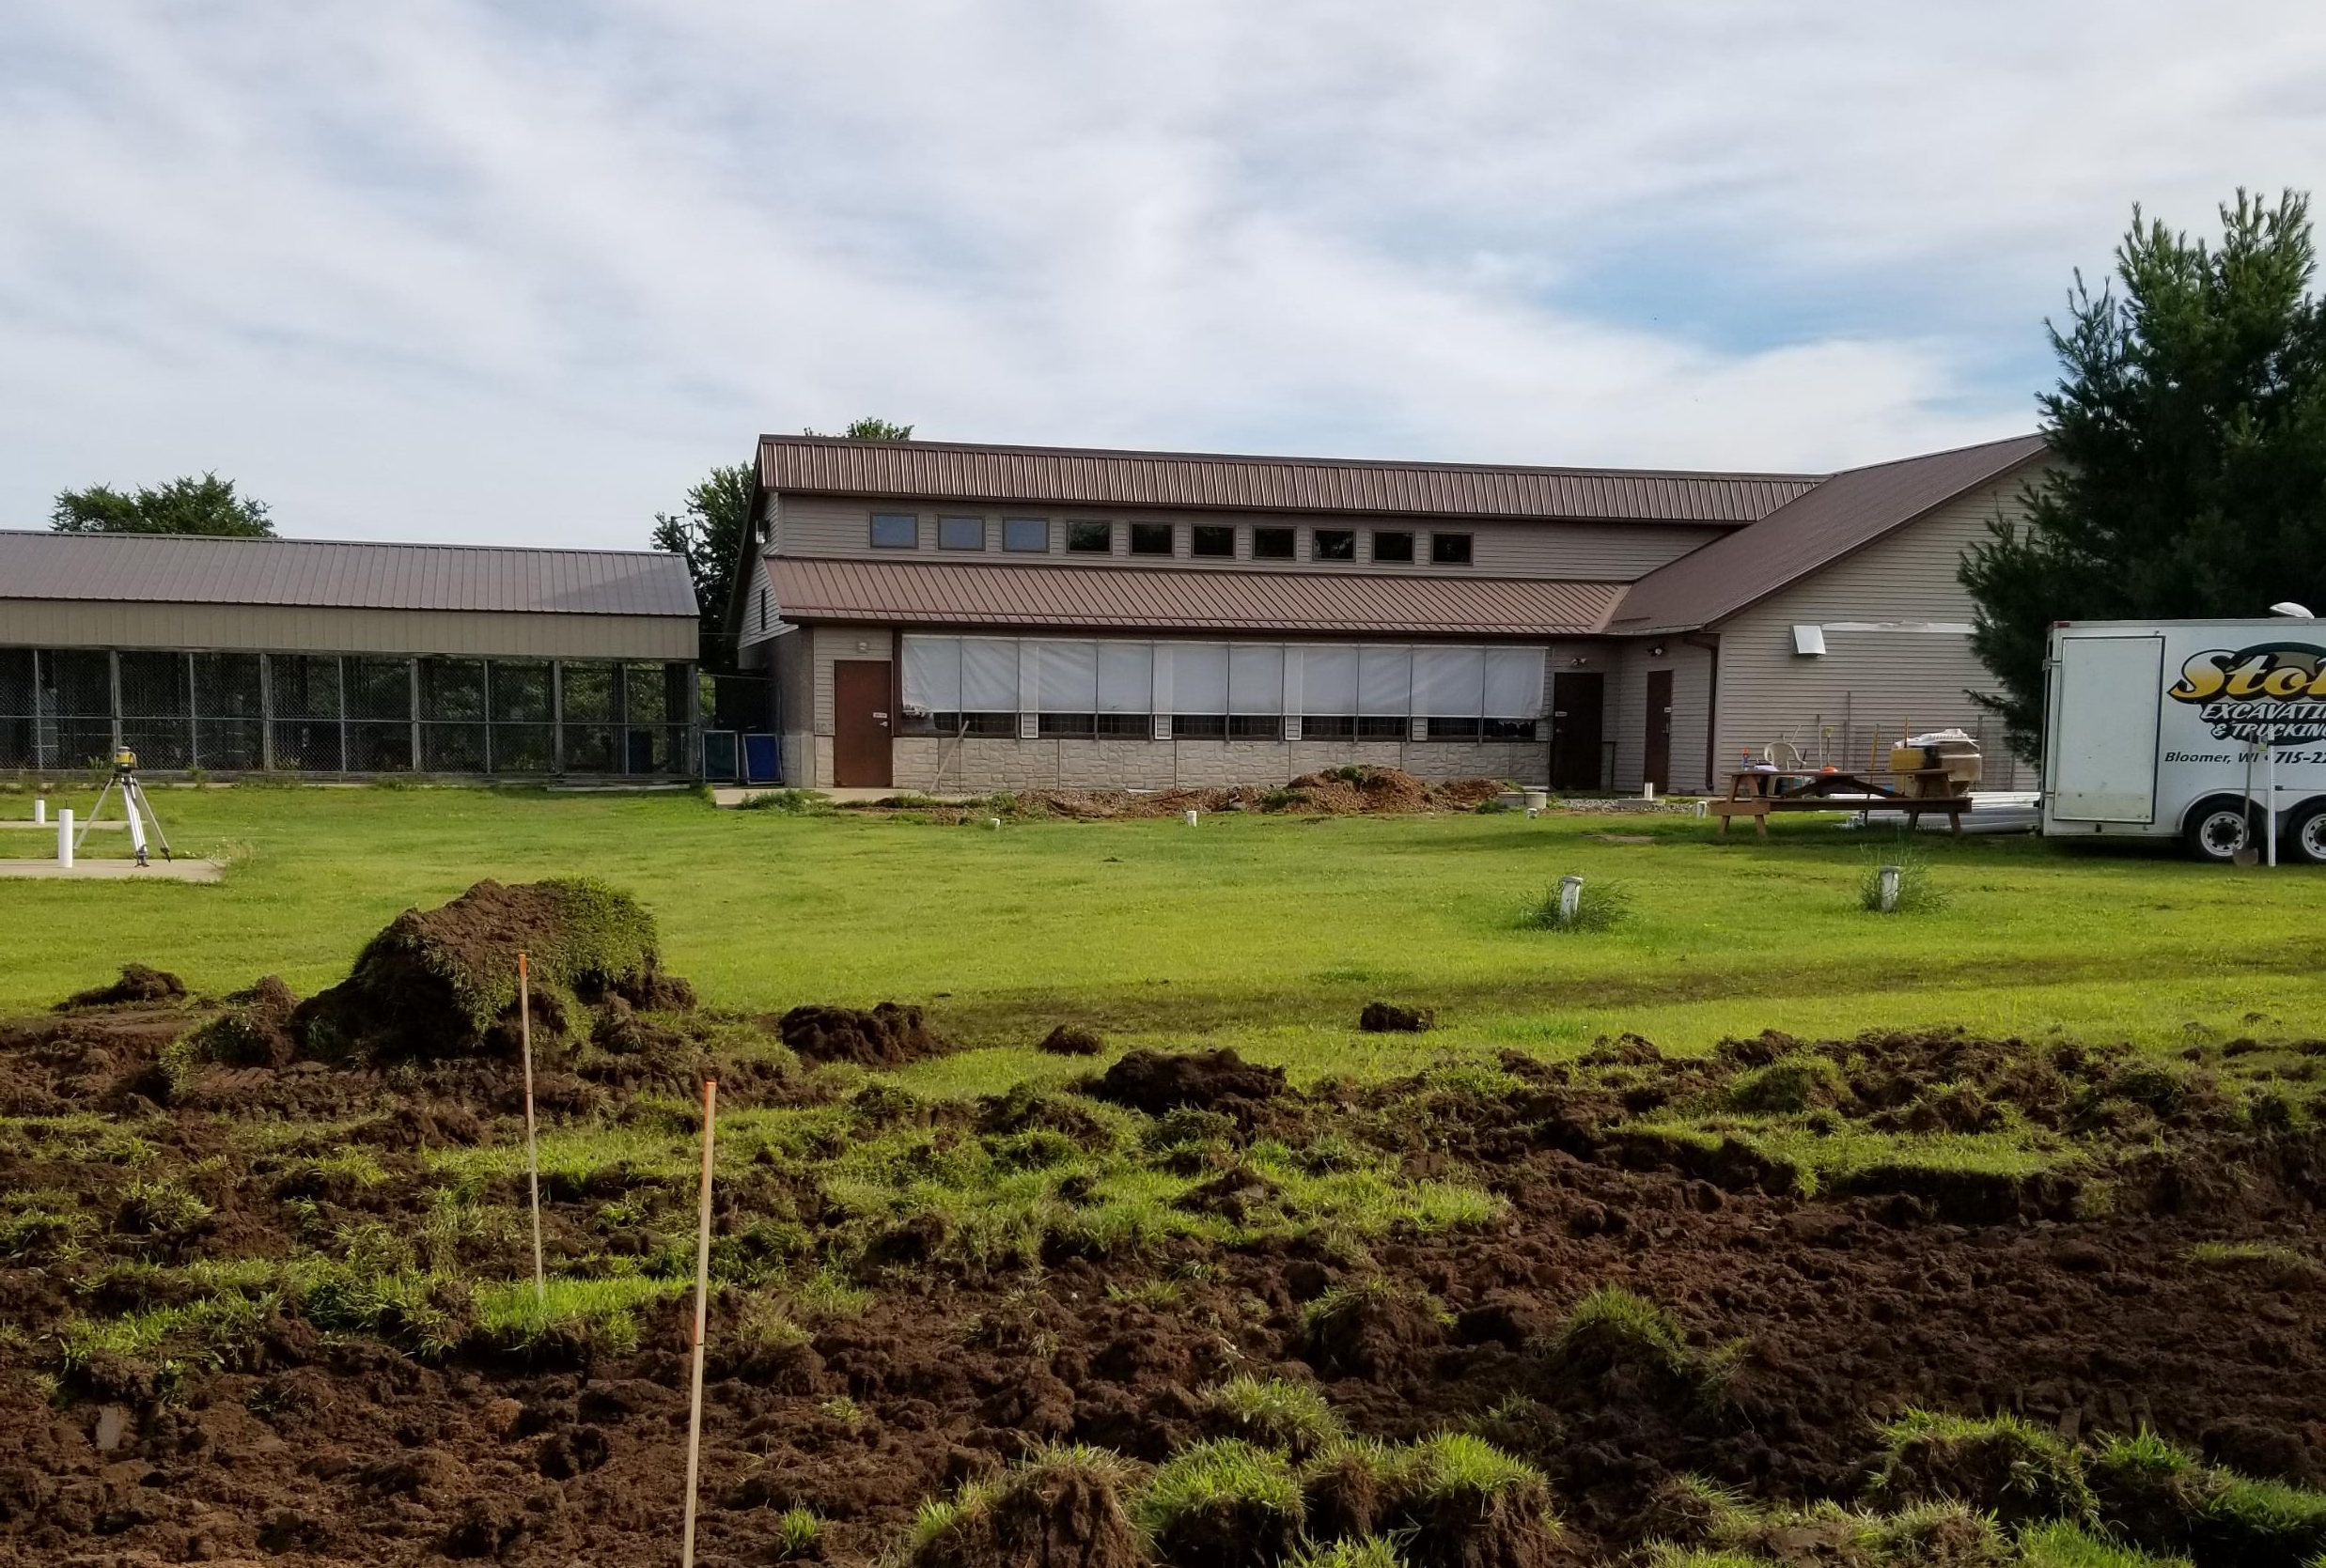
From 341 GPD to 2000 GPD based on metered flow of 1116 gpd
Average flows 897
.17# of BOD

Slide 16
High strength

Slide 17
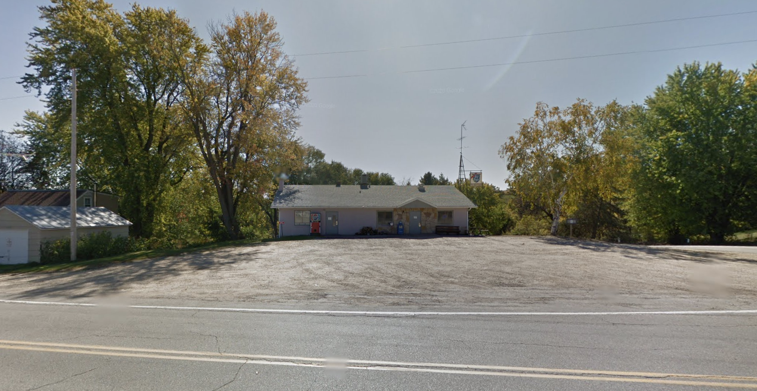
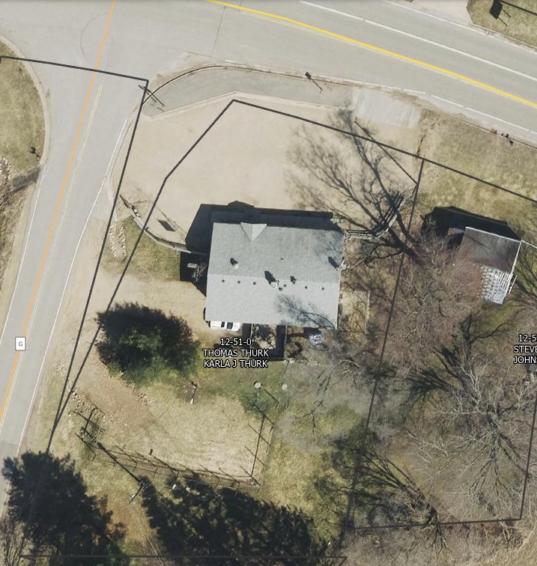
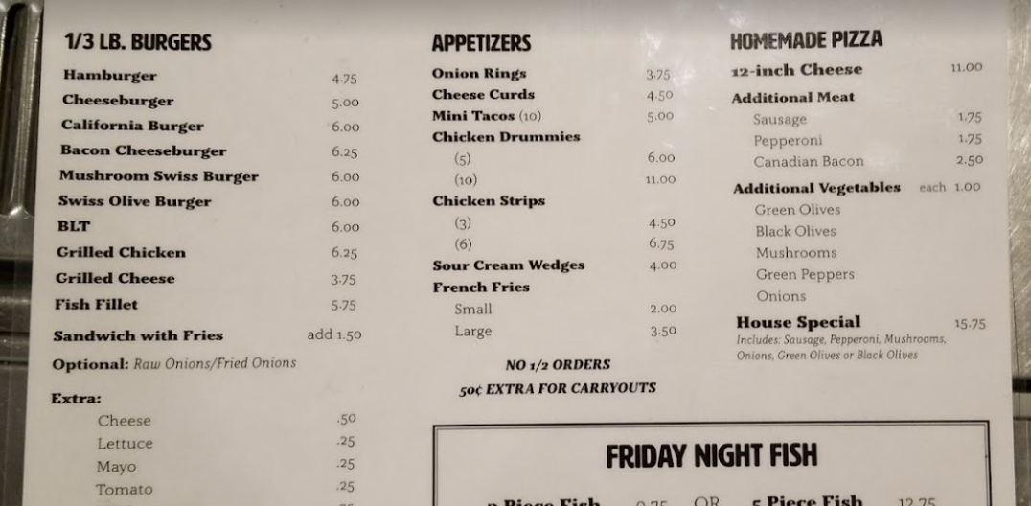

Slide 18
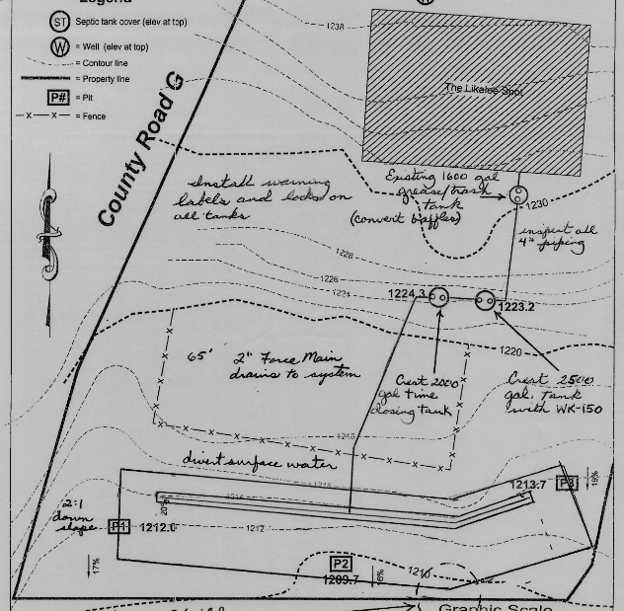
600 GPD Designed
262 mg/L BOD in septic tank
1.3 # of BOD
Actual Flow 264
.57# of BOD

Slide 19
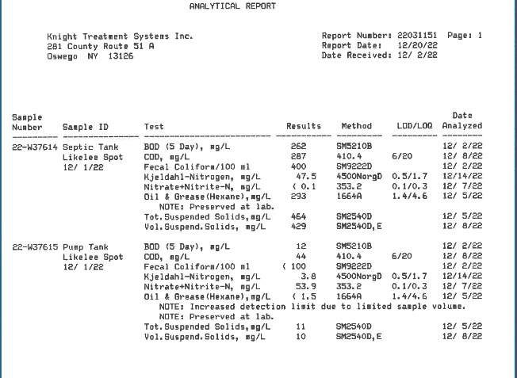
Sampling

Slide 20
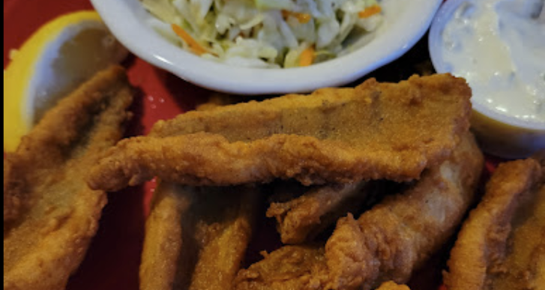
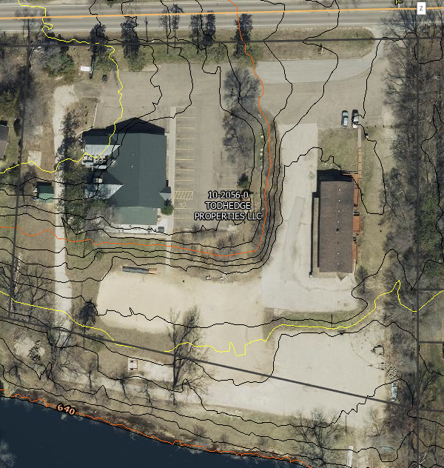
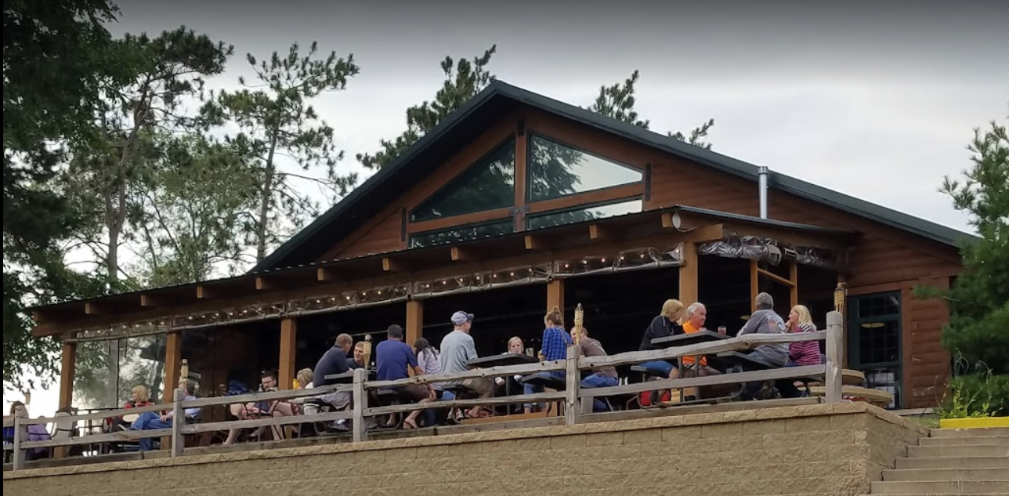

Slide 21
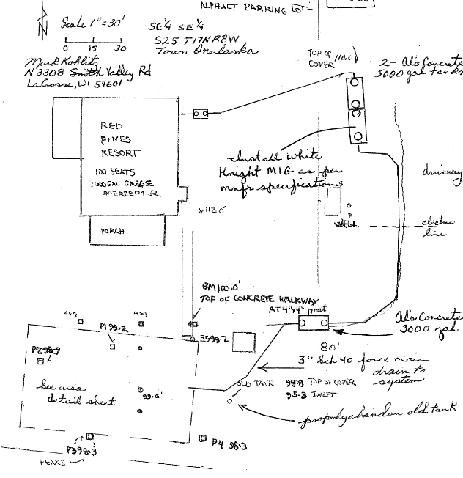
2250 GPD Designed
657 mg/L BOD in septic tank
12.3 # of BOD
Actual flows 1840
10.08 # of BOD

Slide 22
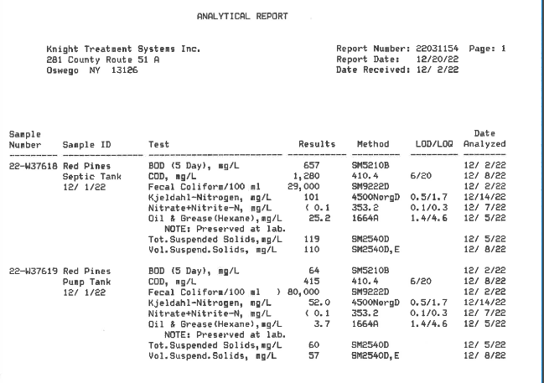
Sampling

Slide 23

THANK YOU!
CeCe Rudnicki
715.403.0726
cece@thesepticgal.com​
www.thesepticgal.com​

