Slide 1
Junk and Sanitary Violations
Discussion Panel
Chris Meuer Calumet County
Terry Ochs Dodge County
Reed Gaedtke Manitowoc County
Karl Jennrich Oneida County
Chris Mrdutt Portage County

Slide 2
How many people take care of complaints in your office?
Citation Amounts?

Slide 3
Junk Violations
Describe your violation process.
Do you accept anonymous complaints or require a formal submittal? (Signature?)
How much information is required from the complainant?
Do you conduct an onsite inspection?
Notify the property owner of the inspection?
How many people go on that first onsite?
Photos or Video?

Slide 4
Evidence Shows It is a Violation
Now What?
Describe the process from start to finish.
How many letters do you send?
How much time do you give them?
If you issue a citation what then?
Do you go to court for each citation you write?
Do you send a correction order or any notices via certified mail?
When do you decide it’s time to go to court?

Slide 5
How does Your court Process Work?

Slide 6
What if they don’t comply with court orders?
How do you handle repeat offenders?

Slide 7
Does your county clean a property up if the owner fails to?
Does your county charge the property owner with the cost of cleaning the property?
If so, How do you do it?

Slide 8
Septic Violations
Failing septic complaint
vs.
Failure to maintain the system

Slide 9
Septic Violations
Scenario:
A citizen complains their neighbor's septic is failing. What are your next steps?
How much information is required from the complainant?
Do you conduct an onsite inspection?
Notify the property owner of the inspection or do a drive-by onsite?
How many people go on that first onsite?

Slide 10
Evidence proves it’s a violation; now what?
Describe the process from start to finish.
How much time do you give them?
If you issue a citation, what then?
When do you decide it’s time to go to court?
Take us through the steps of taking someone to court.

Slide 11
Septic Maintenance Violation
Scenario:
Owner fails to complete the 3-year maintenance requirement.
What is your process for proceeding with the violation?
Do you require the violation process to be completed in the year?

Slide 12
Septic Maintenance Violation
If the maintenance inspection/pumping shows the septic is failing, do you start the same process as mentioned earlier for a failing septic or do you do something different?

Slide 13
General Violation Questions

Slide 14
How Do you Find out About Violations
Does your department drive around looking for violations?
Or
Do you only take complaints from citizens?

Slide 15
Town Involvement
What role does a township play in your junk violations?

Slide 16
Law enforcement escort
When do you get police involved?
&
How do you request the escort?

Slide 17
Corporation Counsel
When do you get them involved?
What role does the Corp. Counsel play in your violation process?

Slide 18
Political Reality Regarding Violations
What’s your county’s feelings towards violation enforcement?
Do you get backing from county board or your commission?

Slide 19
Enforcement Letters
What works and what doesn’t?
Are there certain words you feel helps move the process along and are there words you tend to avoid using?

Slide 20
Judges
How to act. (respect)
How to dress.
How much information do you provide?

Slide 21
How to handle hot issues when it comes to media coverage

Slide 22
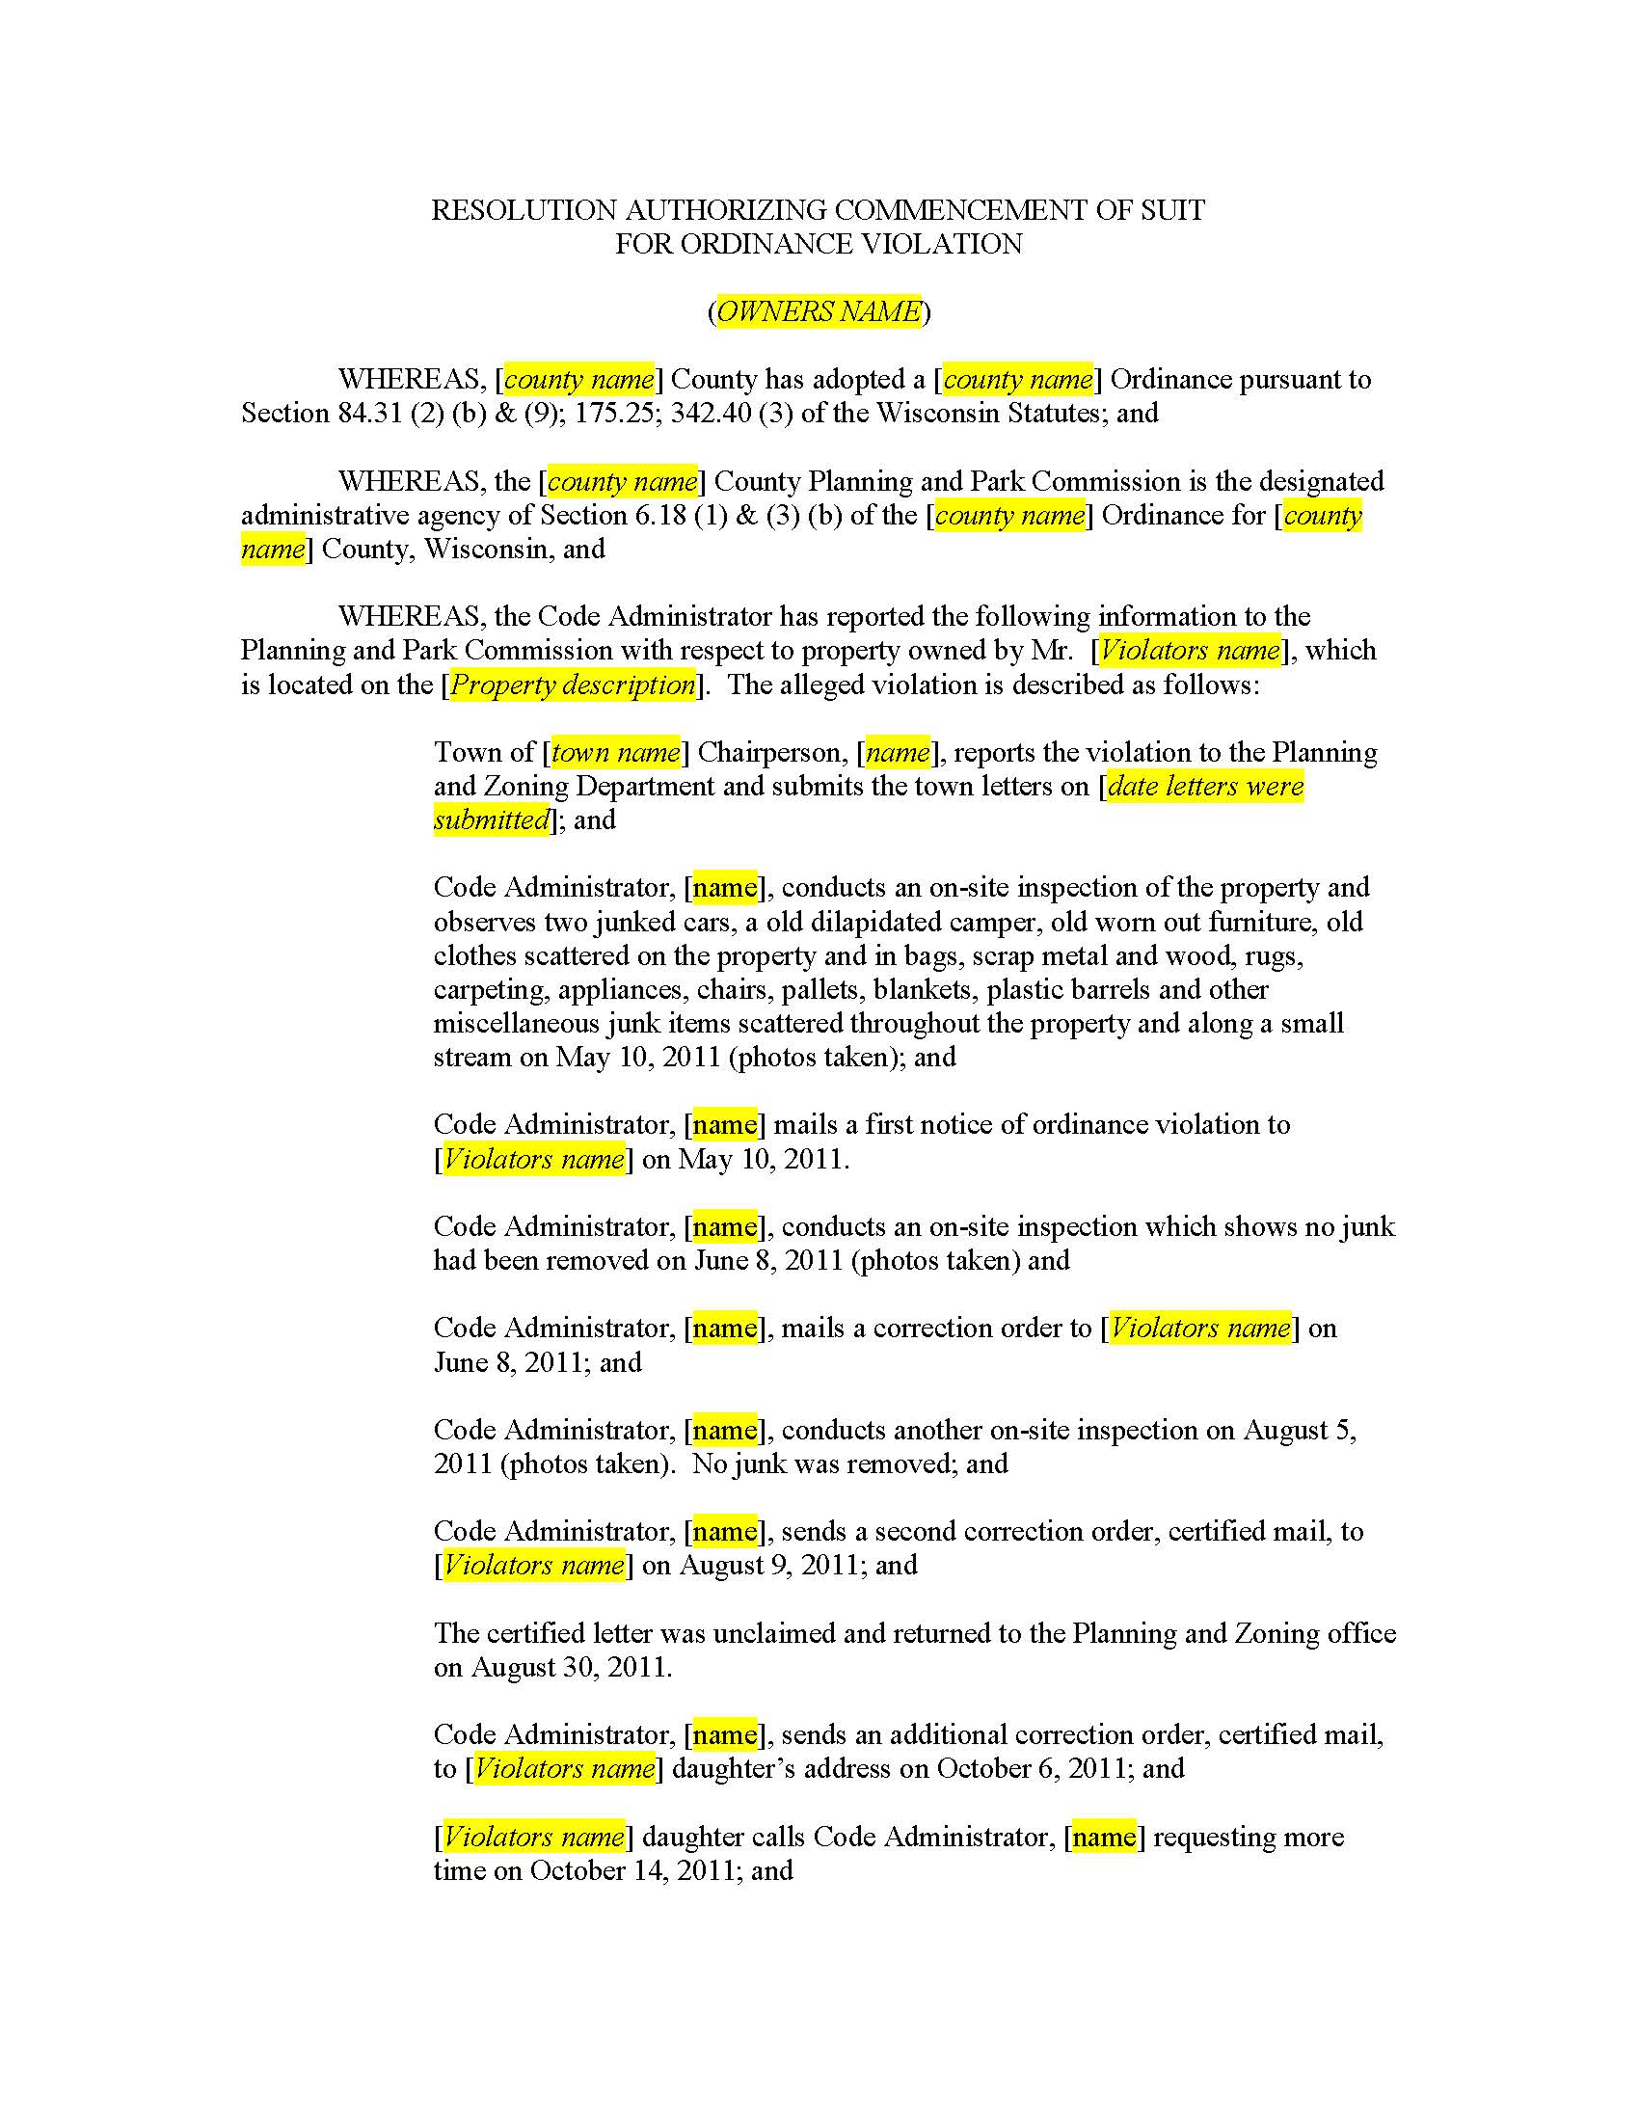
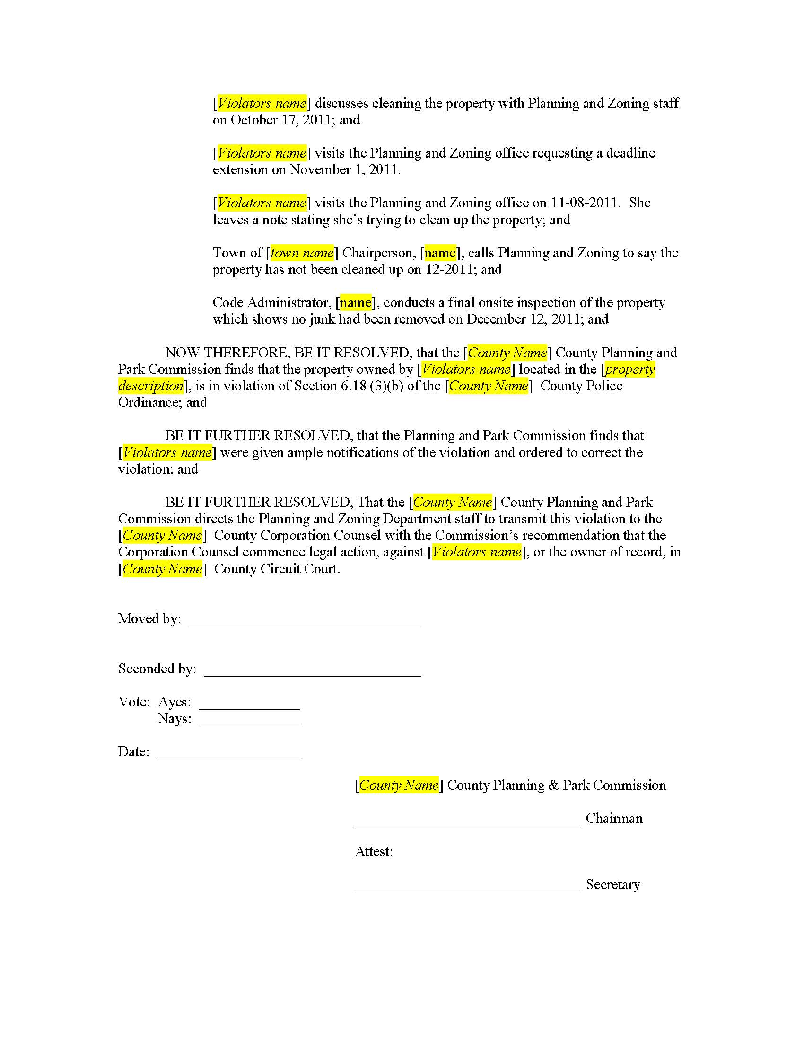
Sample Resolution

Slide 23
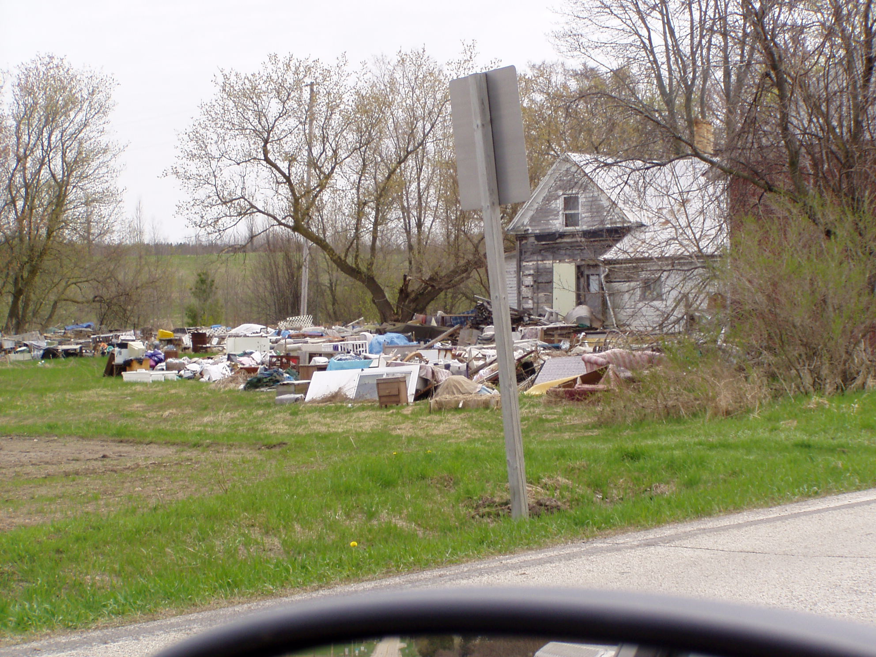

Slide 24
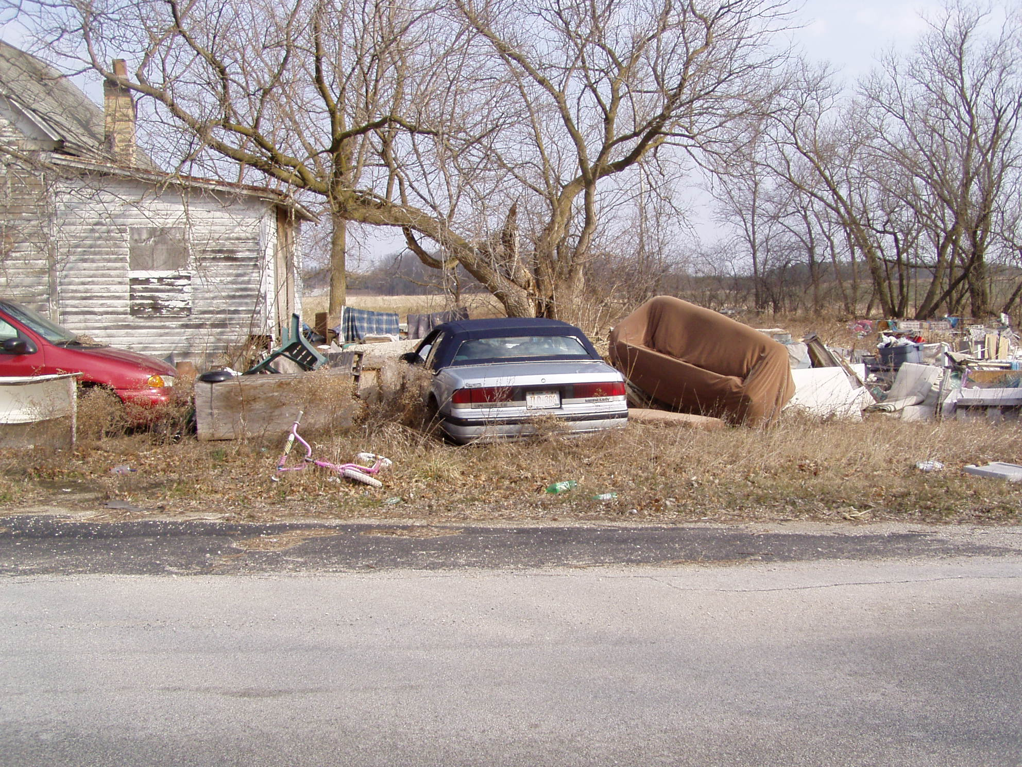

Slide 25
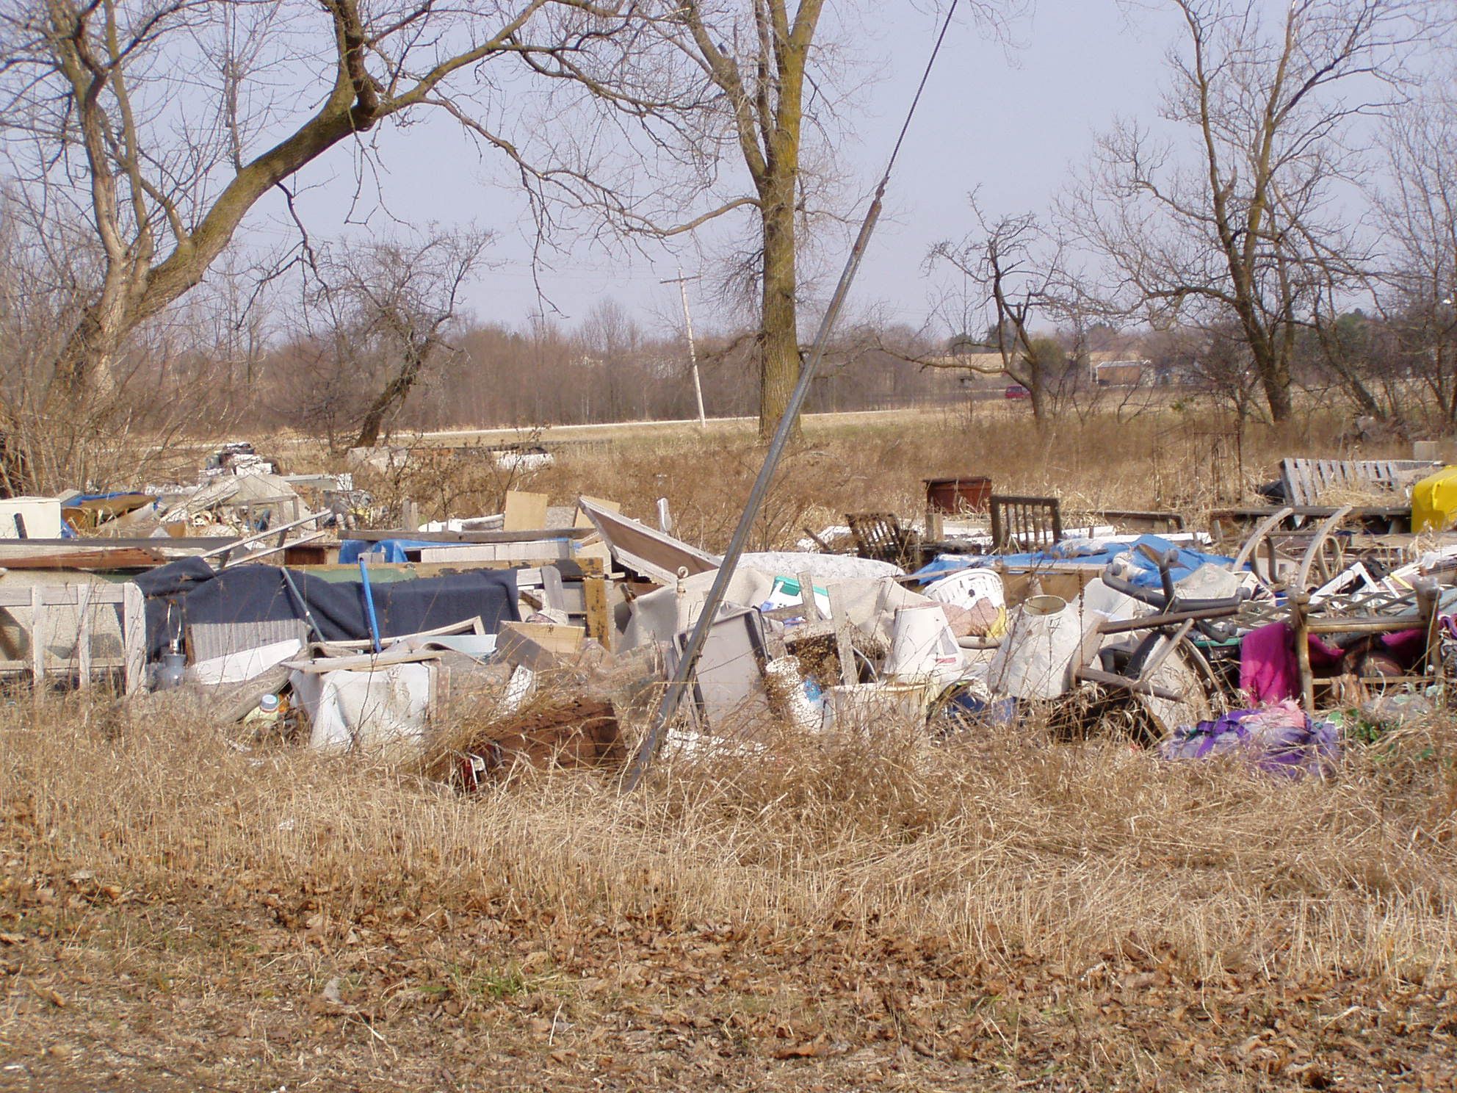

Slide 26
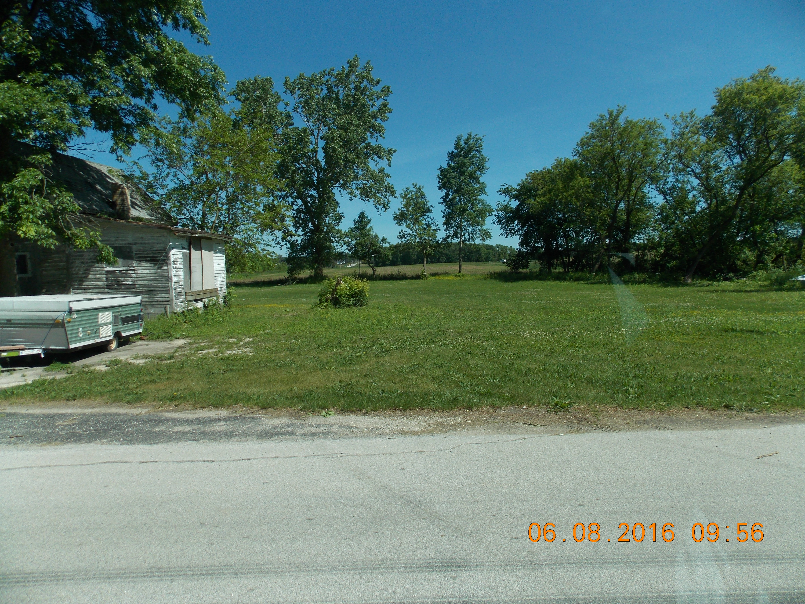

Slide 27
Questions
Chris Meuer chris.meuer@calumetcounty.org
Terry Ochs tochs@co.dodge.wi.us
Reed Gaedtke reedgaedtke@manitowoccountywi.gov
Karl Jennrich kjennrich@oneidacountywi.gov
Chris Mrdutt mrduttc@co.portage.wi.gov
Sample Resolution and County Policy/Procedure Pamphlets Available

